Slide 1



VOIS Innovation
Marathon 2.0

Slide 2




Project Title: Smart Hazard Detector
NITHIN CHOUDARY, CSE
Team No. 36
Insert your professional photo
JSS COLLEGE, BANGALORE
PARITOSH,CSE
POOJA, CSE

Slide 3
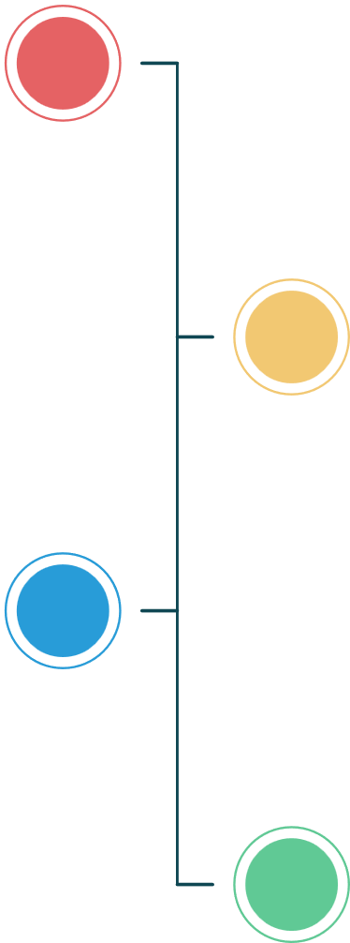




Problem Statement
Smart Hazard Detection
The Challenge: Road safety is increasingly at risk as drivers frequently encounter:
Unmarked road hazards – speed breakers, potholes, and manholes constructed without standard signage or visibility warnings.
Lack of real-time detection – existing navigation systems do not provide live updates about newly formed or temporary road hazards.
Unreliable hazard reporting – dependence on manual inspections and delayed citizen complaints leads to outdated or incomplete hazard information.
Dynamic road conditions – rapid urban development, poor maintenance, night-time driving, and changing road surfaces increase accident risk.
Without a real-time, intelligent hazard detection system, drivers face sudden braking, vehicle damage, reduced driving comfort, and a higher likelihood of accidents, especially on unfamiliar or poorly maintained roads.

Slide 4
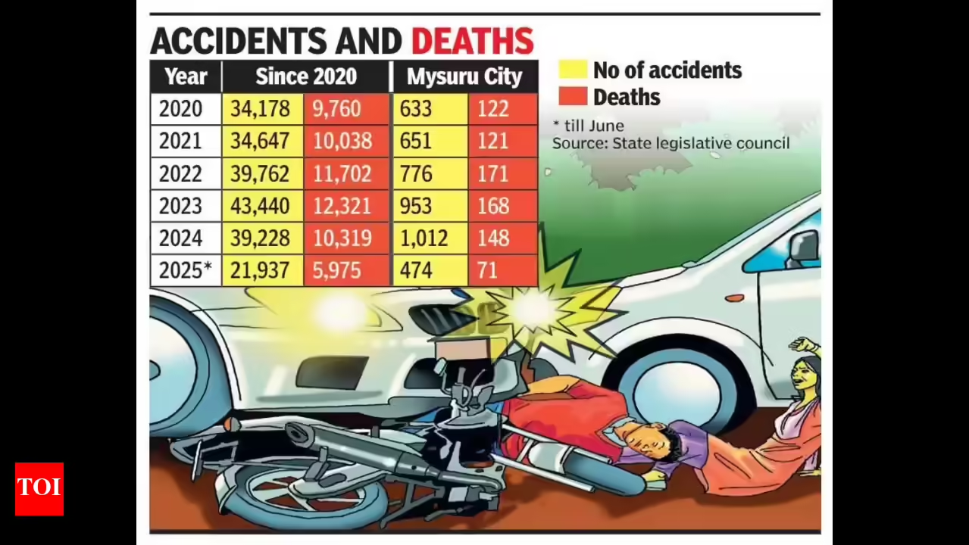
Need of Project

Slide 5
Proposed Solution
The project delivers a real-time, community-driven system that detects, maps, and validates road hazards using change in elevation.
It enhances road safety and driving efficiency by providing timely hazard alerts, accurate visualization, and actionable data for both users and authorities.

Slide 6
Solution Overview
The main device collects data from accelerometer, GPS sensors and change in elevation along z-axis.
The device processes the data using simple signal processing algorithms.
Detected road hazards are stored in a cloud database.
The hazards are displayed on a GIS-based interactive map.
Data is sent and received through the internet.

Slide 7
Technology used
1
Device Sensors (Accelerometer and GPS) and Signal Processing Techniques
2
Google Maps JavaScript API
3
Firebase (Firestore & Authentication)
4
Frontend Technologies (Vite + React + Tailwind CSS)
5

Slide 8
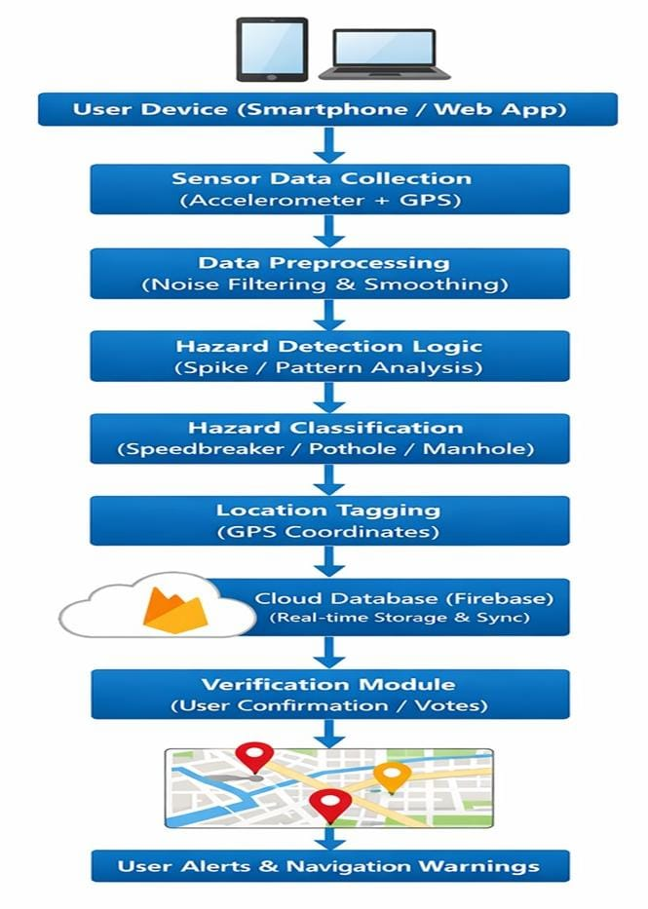
Technical flow diagram -

Slide 9
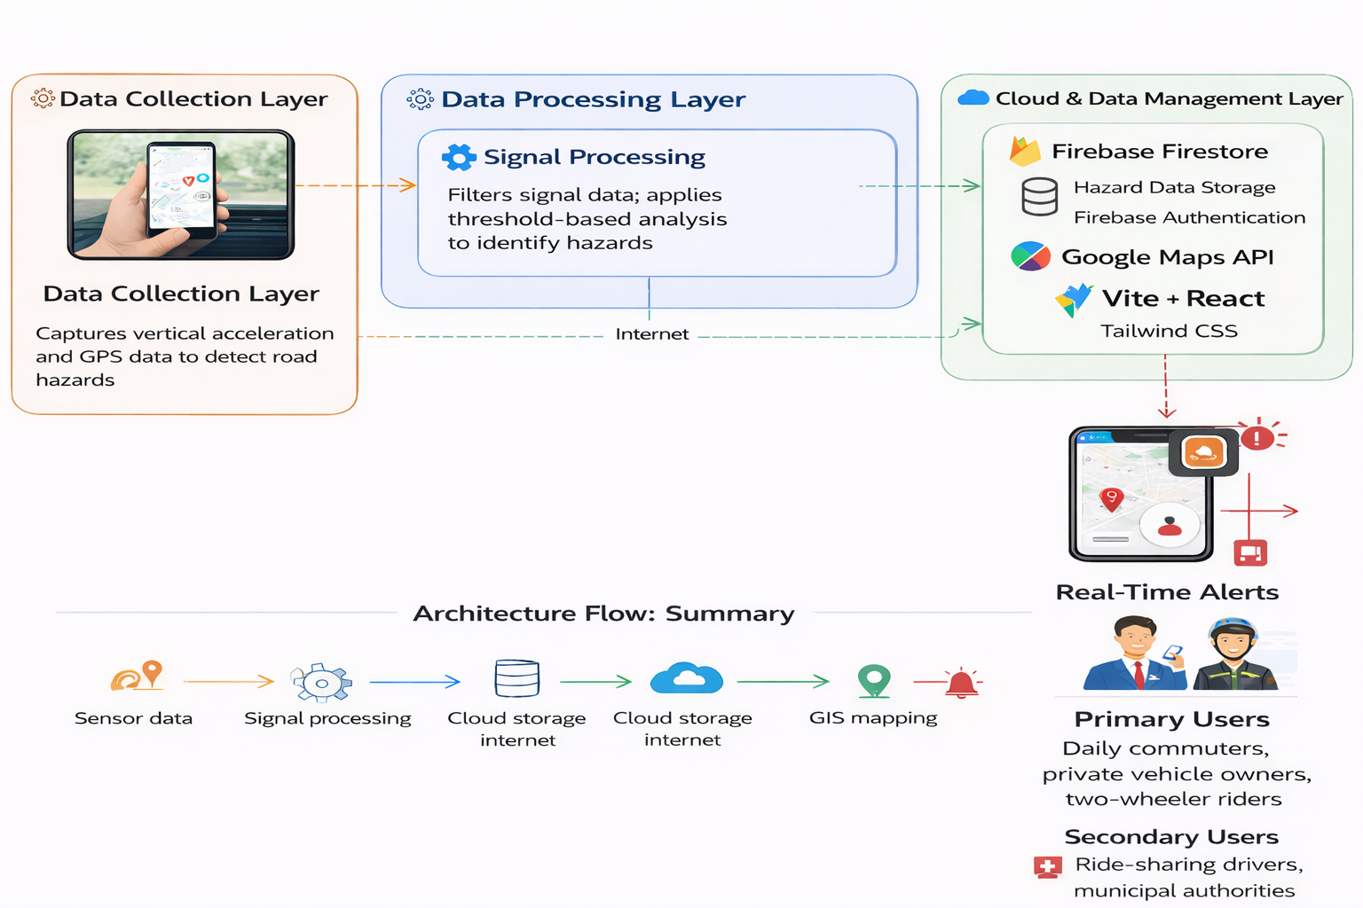
Architecture Blueprint

Slide 10
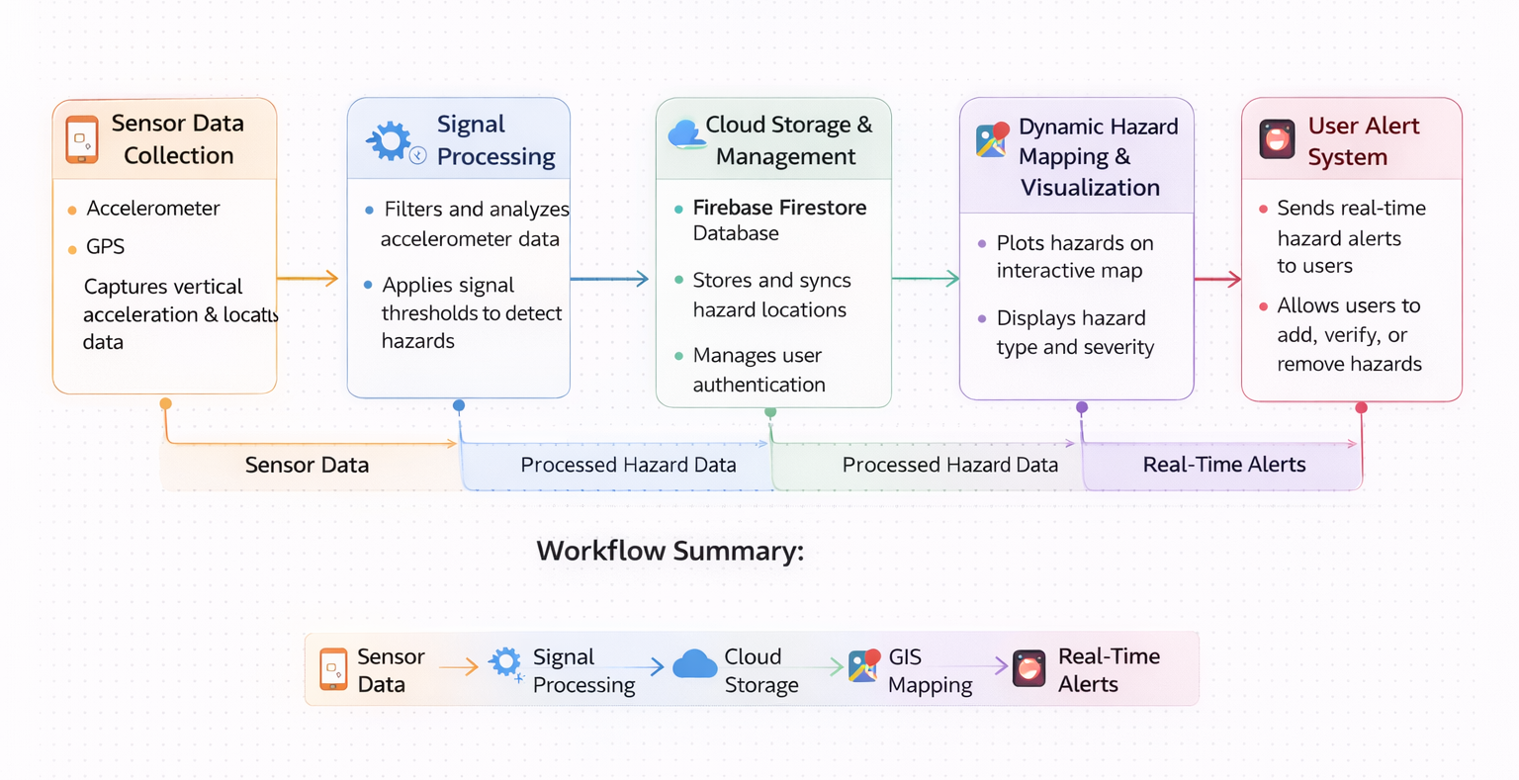
Workflow diagram

Slide 11
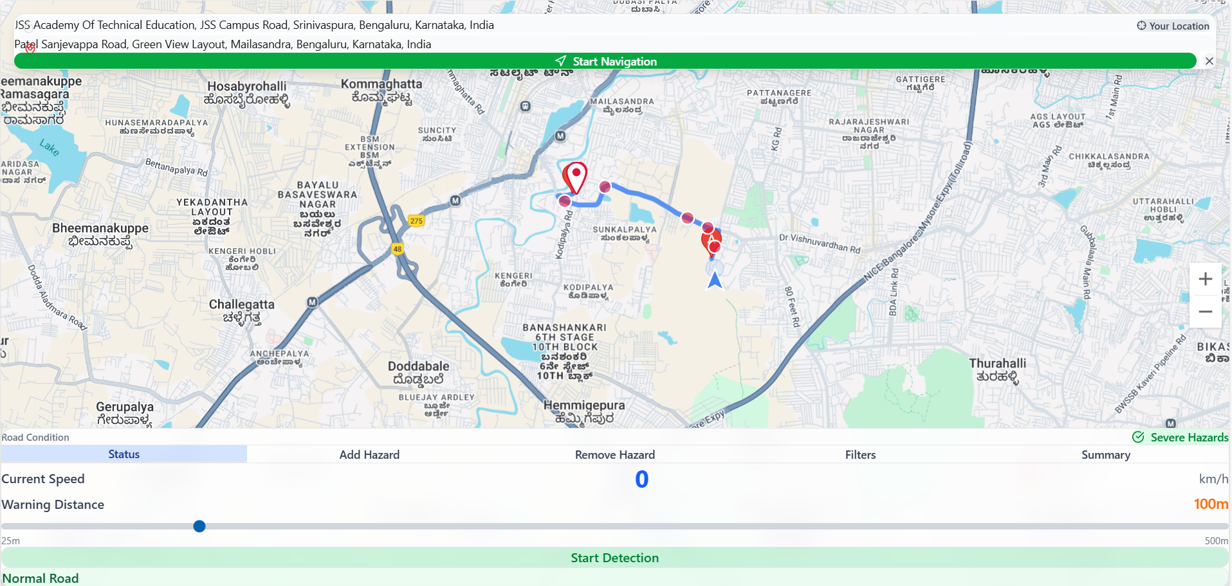
Screenshot 1 of our project :
Fig.1. Shows unmarked speed breakers

Slide 12
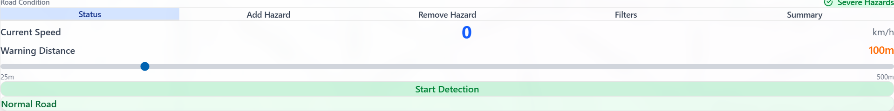
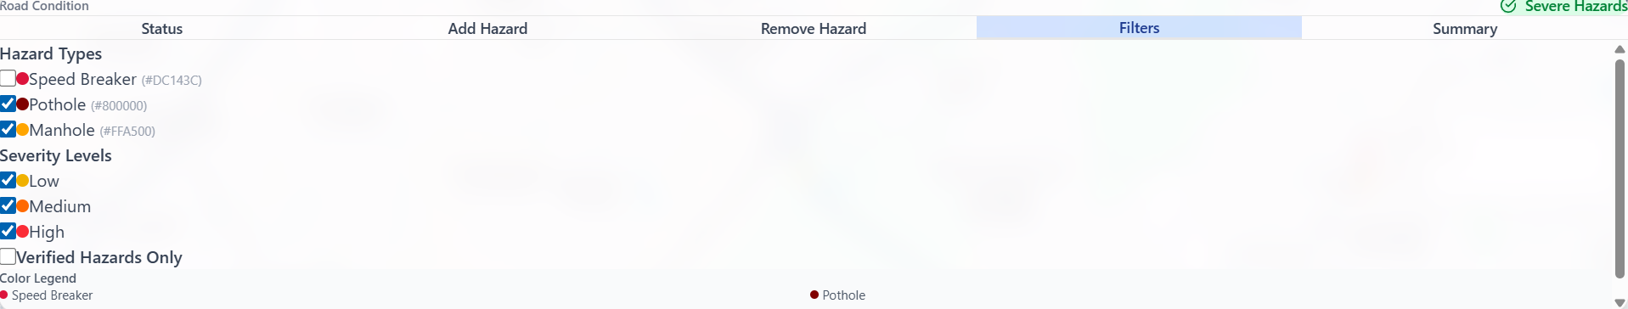
Screenshot 2 of our project :
Fig.2. Adjustable Distance Feature
Screenshot 3 of our project :
Fig.3. Shows Hazard types and Severity levels

Slide 13
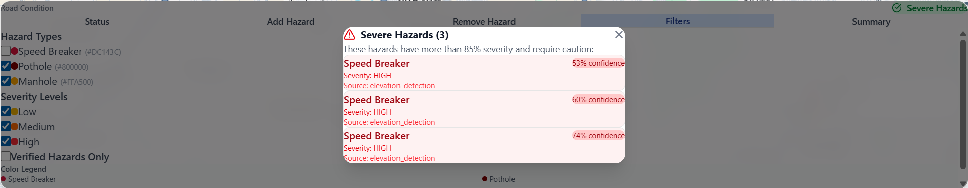
Screenshot 4 of our project :
Fig.4. Shows Severe Hazards

Slide 14
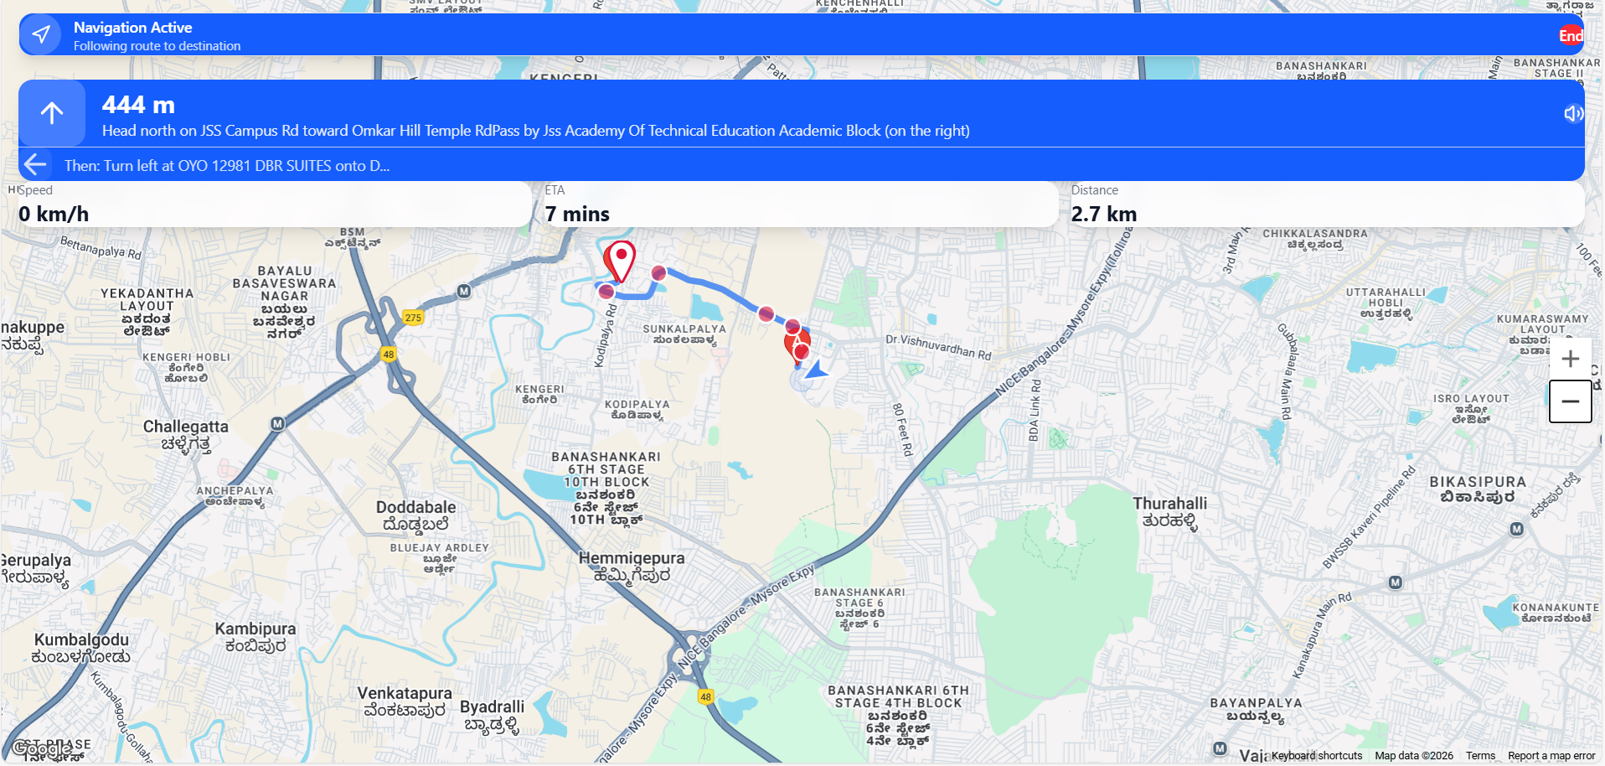
Screenshot 5 of our project :
Fig.5. Navigation and Voice Assistance Features

Slide 15
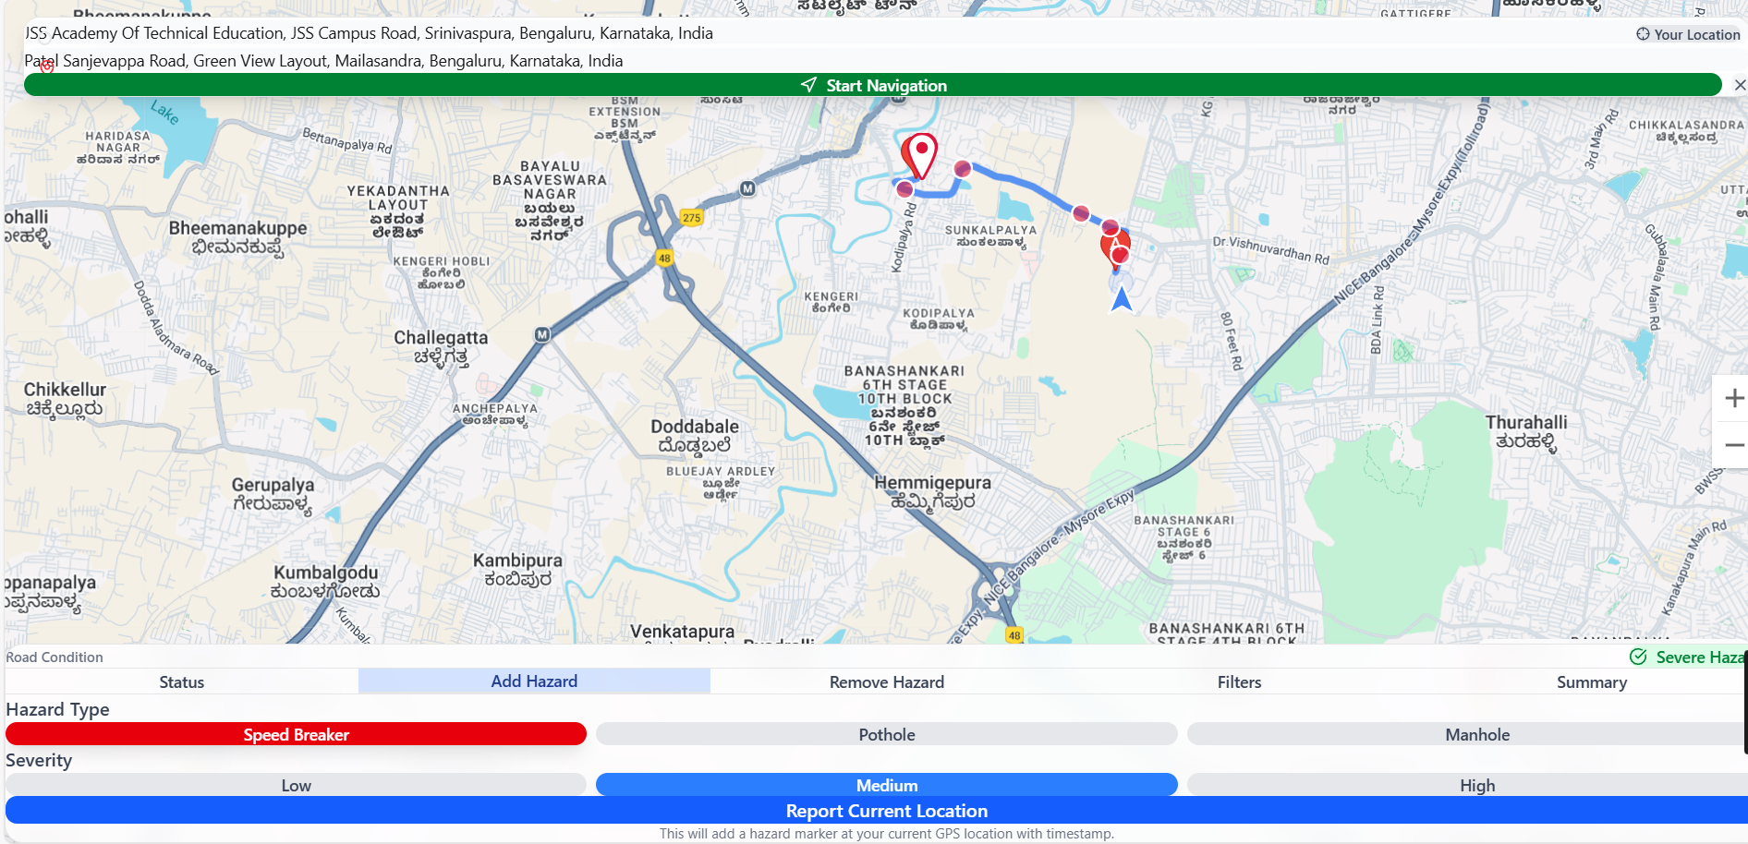
Screenshot 6 of our project :
Fig.6. Adding Hazard Types and Severity Levels Features

Slide 16
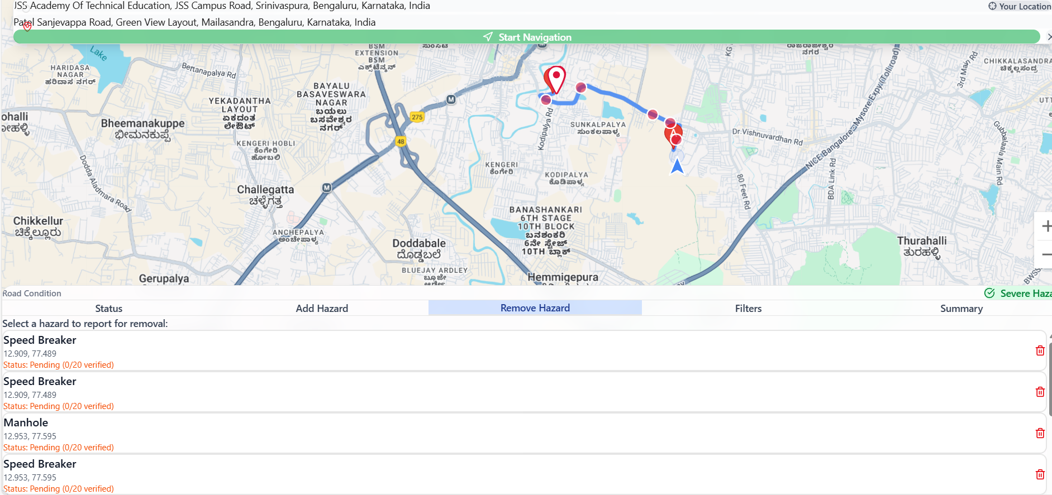
Screenshot 7 of our project :
Fig.7. Removal of Hazards Features

Slide 17
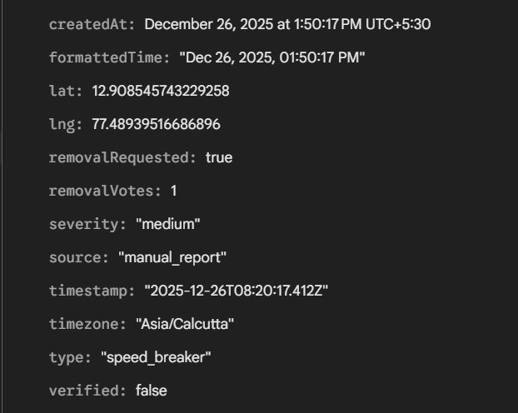
Screenshot 8 of our project :
Fig.8. Database Record For Removal Request

Slide 18
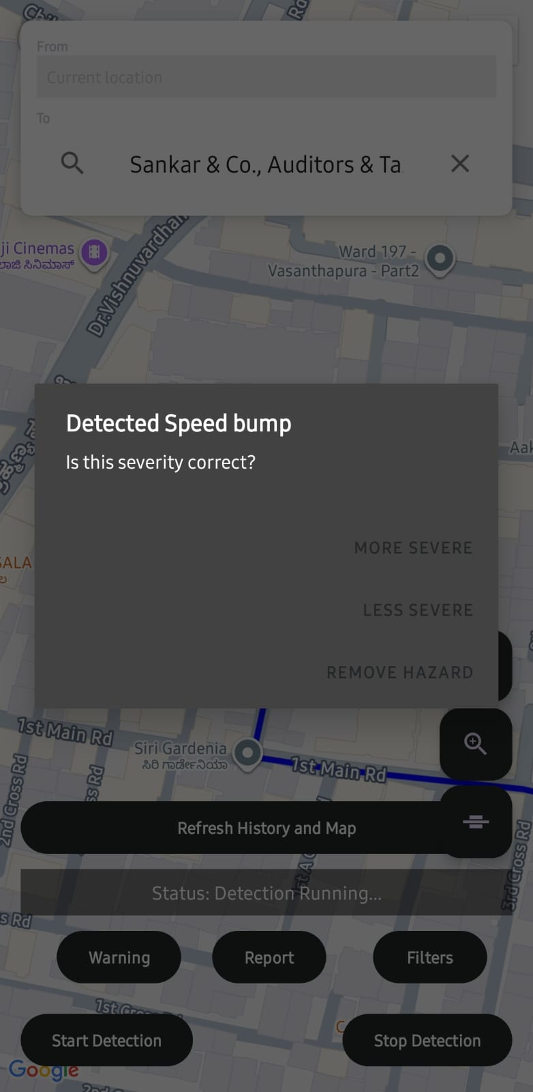
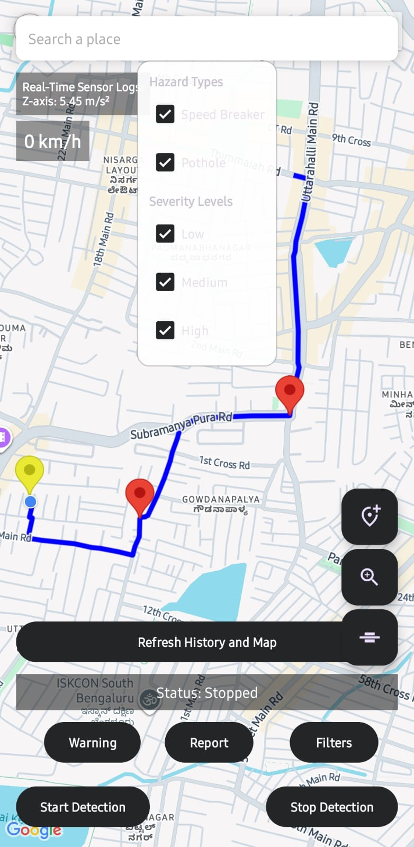
Screenshot 9 of our app:
Screenshot 10 of our app:
Fig.9.Hazard Types
Fig.8. Speed bump detected

Slide 19
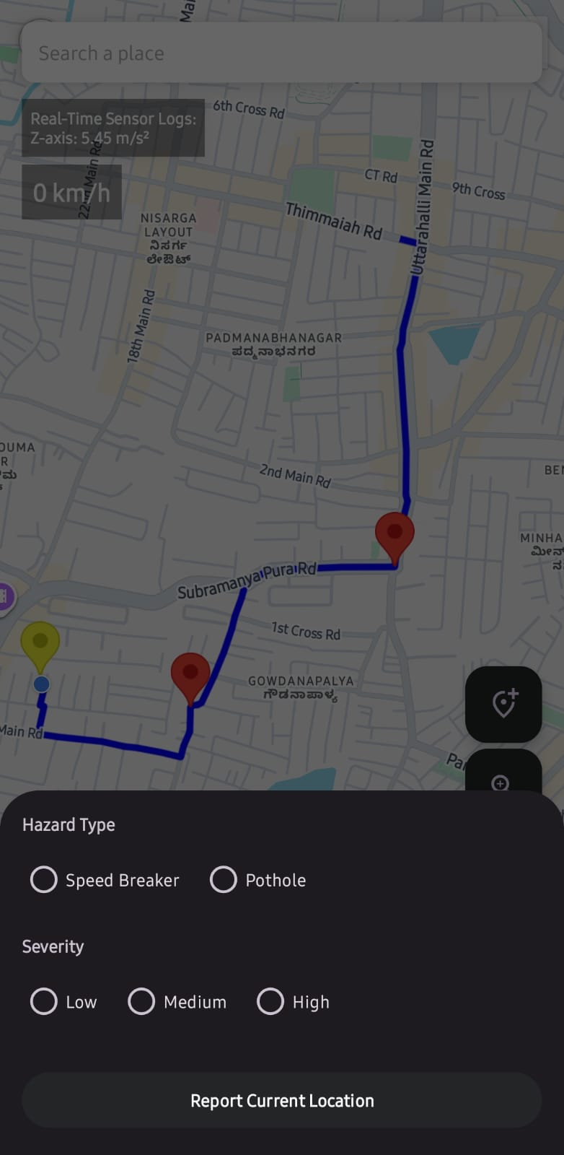
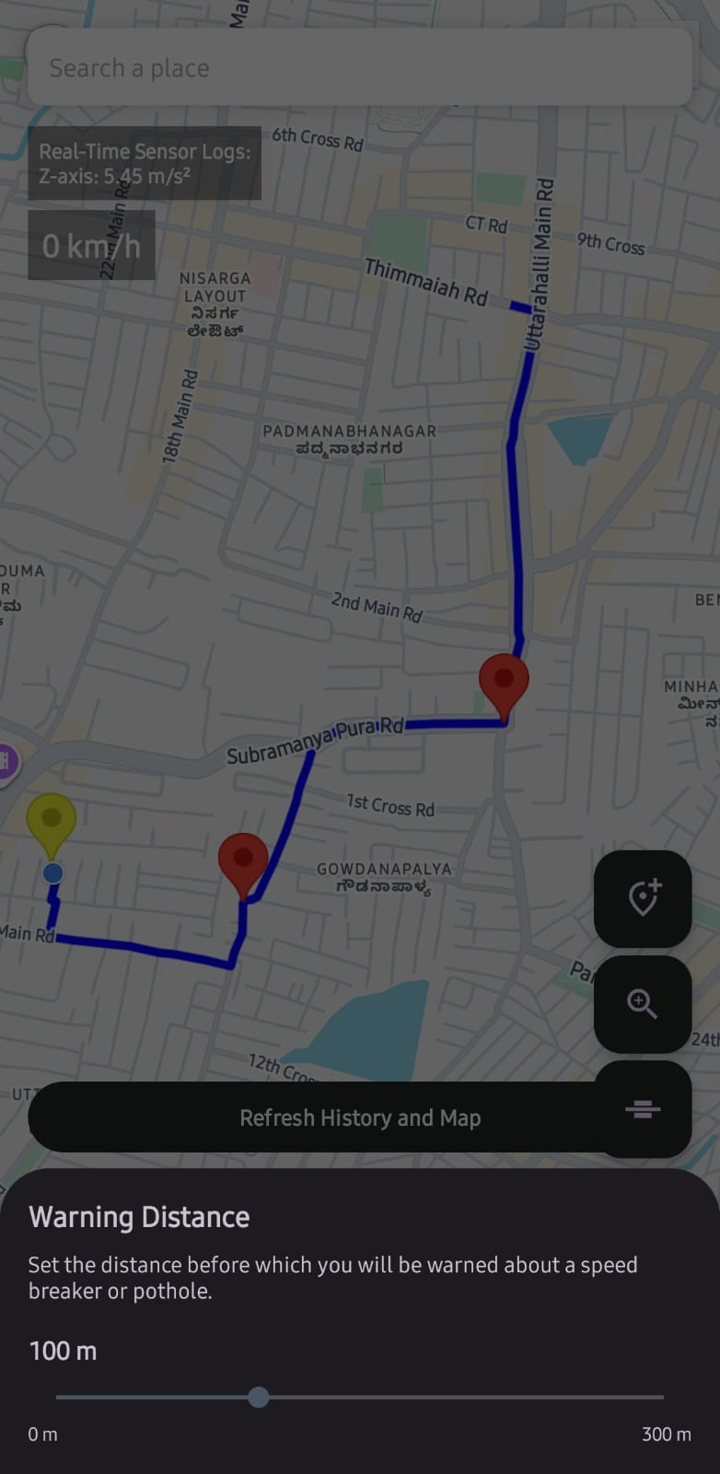
Screenshot 11 of our app:
Screenshot 12 of our app:
Fig.8. Manual Hazard Addition
Fig.8. Adjustable Warning Distance

Slide 20
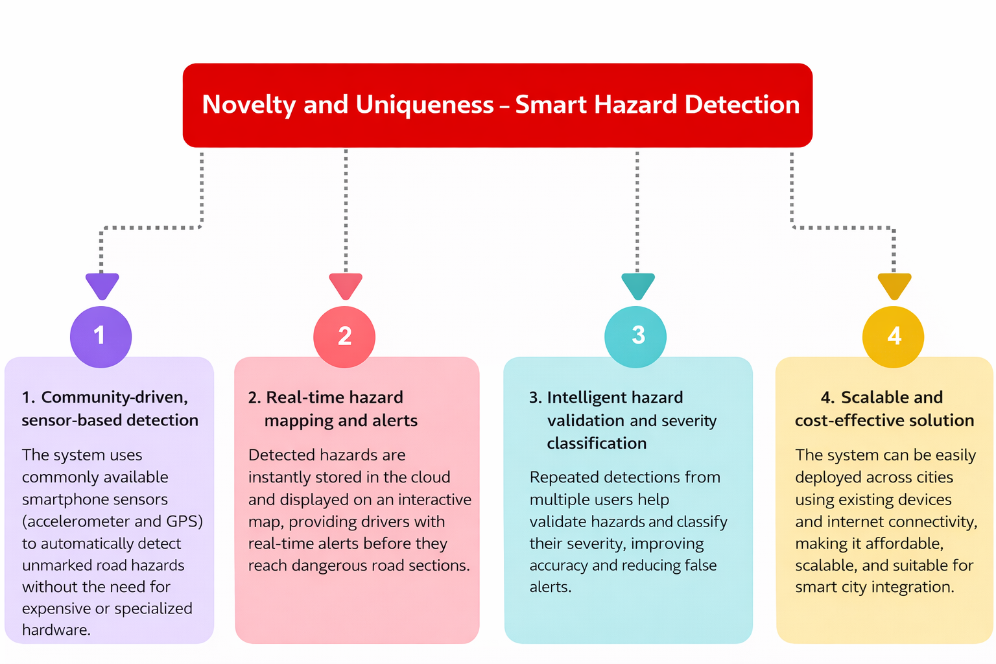

Slide 21
WebApp Git Hub Link
https://github.com/Paritosh-Nilmani/SmartHazardDetector
Native App Git Hub Link
https://github.com/attipatlanithinchoudary-cpu/SpeedBreakerDetector-RoadGuard-
Project Demo Link
https://smart-hazard-detector-seven.vercel.app

Slide 22
Future Scope
Integration with smart city infrastructure and IoT devices can enable automated hazard detection and real-time alerts.
Cross-platform support for wearable devices can make the system accessible to all road users, ensuring seamless hazard monitoring and verification.

Slide 23
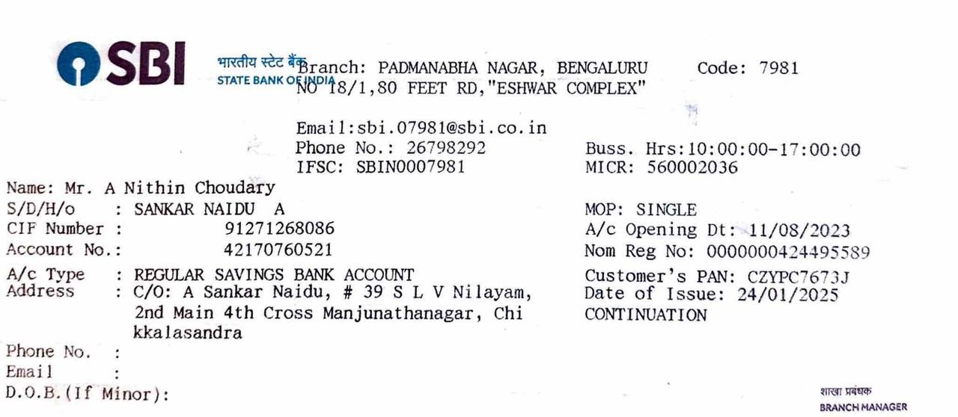
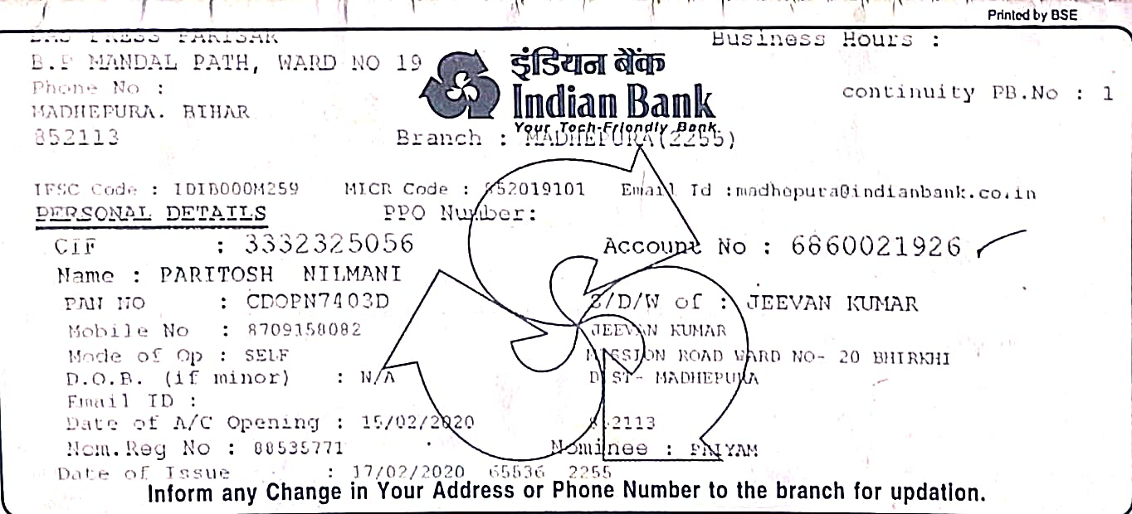
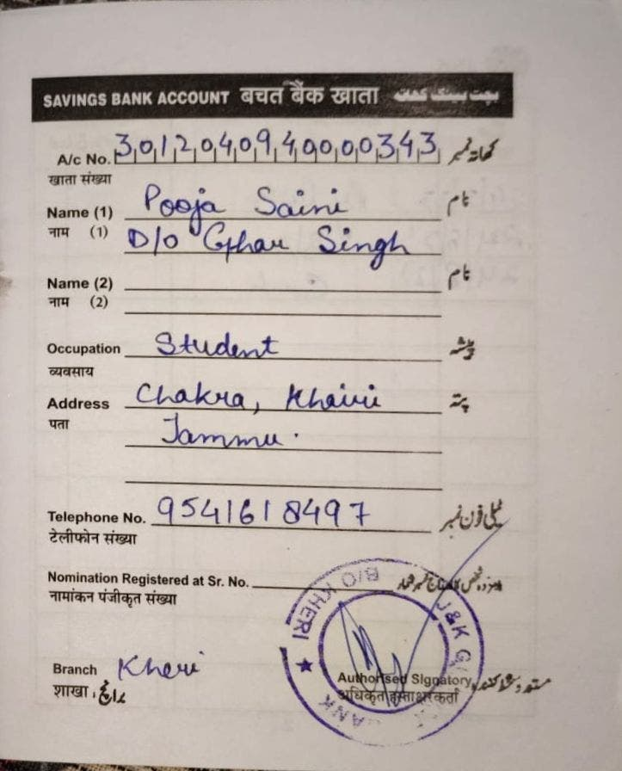
Bank Details
Full Name (as per bank records): | Bank Name | Branch Name | Account Number | Account Type (Savings / Current) | IFSC Code
NITHIN CHOUDARY | SBI BANK | PADMANABHA NAGAR | 42170760521 | SAVINGS | SBIN0007981
PARITOSH NILMANI | INDIAN BANK | MADHEPURA MAIN | 6860021926 | SAVINGS | IDIB000M259
POOJA SAINI | J&K GRAMEEN BANK | KHERI | 3012040940000343 | SAVINGS | JAKA0GRAMEN
NITHIN CHOUDARY
PARITOSH NILMANI
POOJA SAINI

Slide 24


